Slide 1



Slide 2
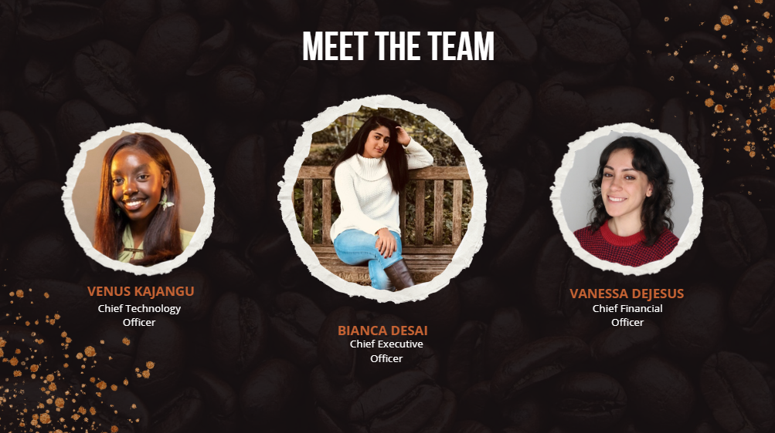

Slide 3
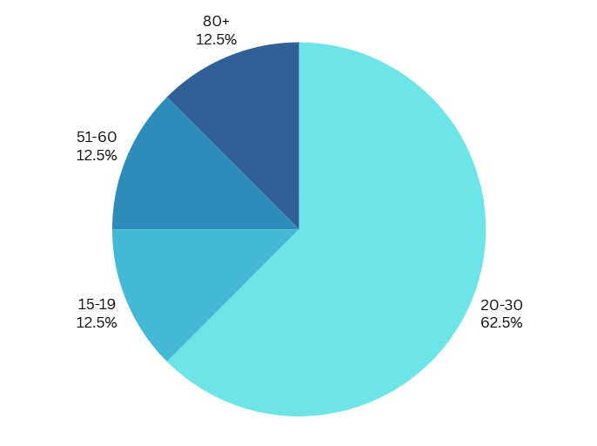
We asked people for their age range. We found that most of our respondents are between the ages of 20-30.

Slide 4
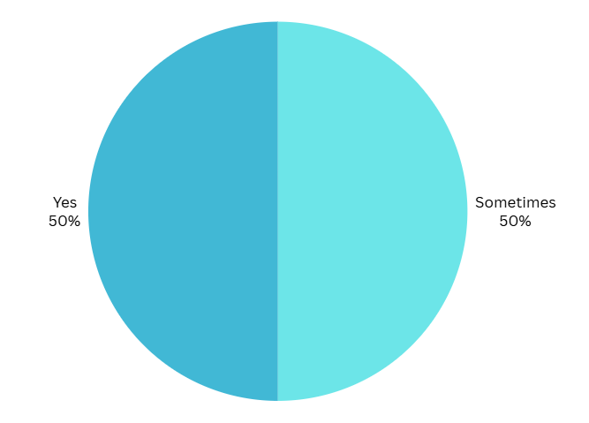
We asked people if they drink coffee. The only responses we got were “Yes” and “Sometimes”.

Slide 5
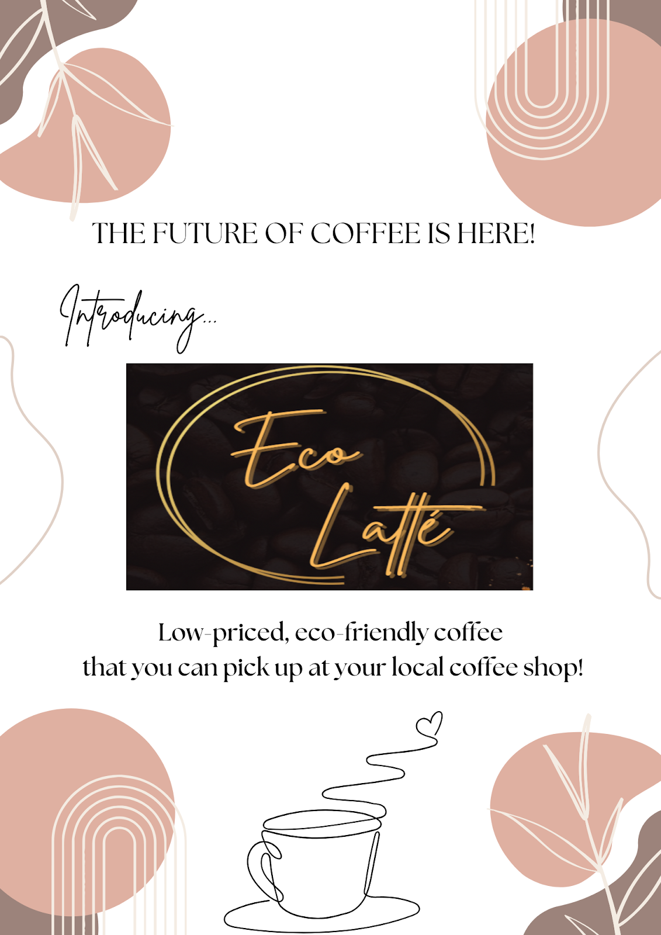
Likes:
“Low price & local shop”
“The color scheme”
“it’s cute love the colors”
“it’s clean and simple”
Dislikes:
“the logo shouldn’t have a black box around it”
“The middle logo, it contrasts the background a lot”
“Need more color”

Slide 6

Likes:
“very clear, and love the colors and images”
“The “green” concept for eco friendly coffee”
“Simple”
“I like how it ties into the eco part”
Dislikes:
“the middle doesn’t match the rest”
“The colors”
“The font/format not matching the logo”
“Only the logo! I wish it went with the background”

Slide 7
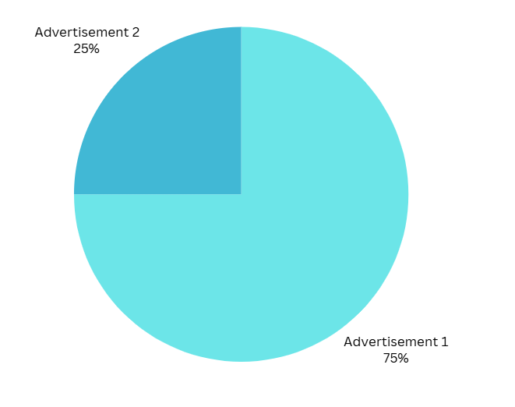
We asked people which advertisement they liked more, and 75% of people liked the first advertisement better.

Slide 8
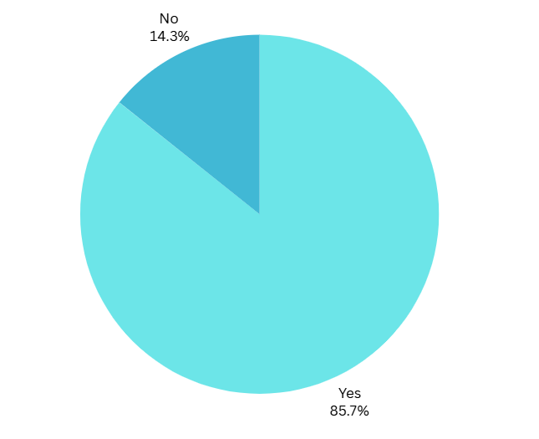
We asked people if they would replace their current coffee choice with ours if it was available at their coffee shop. Most people said yes.

